Slide 1
Customer Experience Analysis for Singapore Airlines

Slide 2
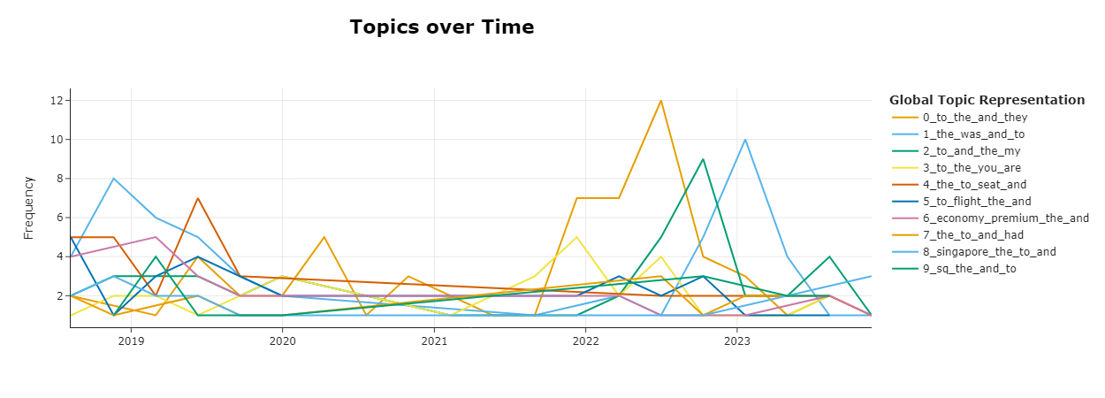
Objective
The reputation of Singapore Airlines for delivering excellence in service has undergone changes according to recent reviews which show diminishing satisfaction among specific customer groups (Ban et al., 2019). This analysis intends to examine rating declines alongside NLP-based underlying cause detection methods to deliver executable strategies to the CEO for enhancing customer experience.
Modeling by Year (Post-2018)
The analysis of customer complaint development utilized BERTopic's topics_over_time feature on reviews rated one to two stars collected from 2018 forward (Vermulst and Lysanne, 2024). Our analysis of reviews across time revealed exact periods when customer dissatisfaction became worse along with the main topics consumers discussed (Fernandes et al., 2018).
Key Findings
Spike in Operational Complaints: Flight delays and cancellations together with uncertain schedules became more frequent throughout the pandemic period.
Escalation of Baggage-Related Issues: The aviation industry witnessed a sharp increase in misplaced luggage complaints after the year 2020.
Service Quality Perception Deteriorated: The general public started to develop increasingly negative emotions toward the behavior of flight crew personnel.
The graph demonstrates how post-2018 service-quality problems sharply increased.

Slide 3
Key Themes in Reviews (Low vs High Rated)
Low-Rated Reviews (1–2 stars)
1. Lost or Mishandled Luggage: Customers experienced delayed or missing baggage deliveries without receiving appropriate support from airline staff members.
2. Delays and Poor Communication: The lack of informative updates from the airline caused many passengers to experience being ignored and left stranded during situations.
3. Seat Comfort and Cabin Conditions: Economic class passengers consistently criticized both unduly small seating and minimal legroom as well as outdated cabin compartments during their transoceanic air journeys.
4. Negative Staff Interactions: Negative reviews about Airway staff consistently used the words "rude," "unhelpful" and "cold“.
High-Rated Reviews (4–5 stars)
Exceptional Cabin Crew: The crew received positive praise from travelers because they displayed friendliness and attentiveness and professionalism throughout their service.
Smooth, On-Time Flights: Most passengers emphasized both punctual takeoffs and orderly boarding processes.
Premium Experience in Business Class: Reviewers who gave the airline high ratings specifically appreciated the comfortable experience of lie-flat seating and top-tier meals alongside advanced entertainment features.

Slide 4
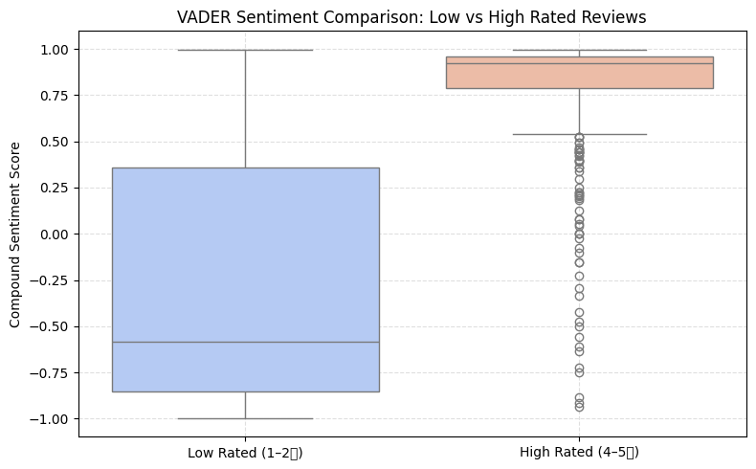
Sentiment Analysis
The detection of customer emotions forms the basis of sentiment analysis while topic modeling serves to uncover the matters customers discuss (Calheiros et al., 2017). The evaluation of customer satisfaction and dissatisfaction used VADER (Valence Aware Dictionary and sEntiment Reasoner) to measure emotional sentiment in both low-rated and high-rated reviews (Sharma et al., 2020).
Findings
Low-Rated Reviews Skew Strongly Negative Reviews rated from one star to two stars presented an average negative sentiment score of -0.28.
High-Rated Reviews Are Consistently Positive The average sentiment rating for reviews that received 4–5 stars amounted to +0.79.
Clear Emotional Divide Between Rating Groups
A boxplot analysis revealed that sentiment scores from both groups nearly excluded each other which validated the BERTopic detected thematic variations.
Boxplot showing sentiment comparison (Low vs High Rated)]

Slide 5
Recommendations to the CEO
Based on our review of over 500 customer reviews using BERTopic, sentiment analysis, and time-based trend modeling, we’ve identified key pain points affecting customer satisfaction (Gargari and Mandis, 2023). The following recommendations are directly informed by these findings and aim to help Singapore Airlines restore its premium reputation and customer trust.
1. Improve Baggage Handling and Communication
The solution requires businesses to acquire a system that tracks baggage in real-time accompanied by automated notifications through email and SMS channels.
2. Re-train Staff in Empathy and Conflict Management
The company needs to introduce updated soft-skills education which focuses on emotional intelligence together with empathy and crisis management training primarily for frontline staff.
3. Address Economy Seating Comfort Issues
The organization should perform an internal seat configuration assessment while investigating ergonomic solutions that use lightweight materials.
4. Enhance Communication During Disruptions
During delays installation of real-time automated communication systems should be deployed for passenger information updates.
References
Ban, H.J. and Kim, H.S., 2019. Understanding customer experience and satisfaction through airline passengers’ online review. Sustainability, 11(15), p.4066.
Vermulst, L., 2024. Detecting Emerging Trends in Customer Satisfaction through Topic Modeling and Mathematical Optimization (Doctoral dissertation, Tilburg University).
Fernandes, T. and Fernandes, F., 2018. Sharing dissatisfaction online: Analyzing the nature and predictors of hotel guests negative reviews. Journal of Hospitality Marketing & Management, 27(2), pp.127-150.
Sharma, A., Park, S. and Nicolau, J.L., 2020. Testing loss aversion and diminishing sensitivity in review sentiment. Tourism Management, 77, p.104020.
Gargari, M.K., 2023. Improving Customer Experience Management: A Dynamic Topic Modelling Approach.
Calheiros, A.C., Moro, S. and Rita, P., 2017. Sentiment classification of consumer-generated online reviews using topic modeling. Journal of Hospitality Marketing & Management, 26(7), pp.675-693.

